Slide 1

TRILOGY FILM PROJECT
R

Slide 2
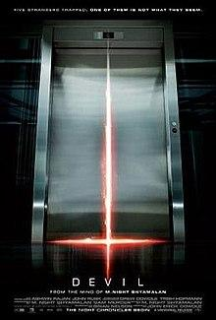
Elevator pitch
In the midst of a pandemic, with little else to do we’ve all been watching more TV and Film. And what better way to escape from the horrors of 2021, than with a horror film itself.
But hands up who has spent more time scrolling through lists of shows, rather than actually watching them? It can sometimes take hours to find a film to match your mood… So why not have an app do it for you?
Enter… HAMMERED HORROR A simple, spooky and easy to use Horror App that will help you find the deadliest match to your darkest of film desires. Hammer your horror preferences into a series of simple selectors and let Hammered Horror do the rest. To make sure you’re in for a treat every time, each title is assigned with our customised “Trick” or “Treat” rating system, which compares scores from Rotten Tomatoes, IMDB and Metacritic to help you sort the shockers from the stunners. So, pick the film, grab the popcorn and find your safest hiding place behind the sofa….

Slide 3
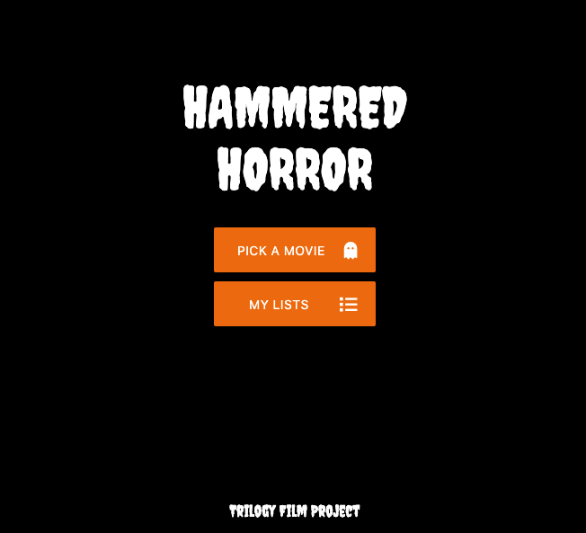

Slide 4

Concept: Description
The Hammered Horror app is a horror-specific film generator.
It uses a series of form selectors to find a title that matches the user’s mood.
The titles that match the user’s criteria are then displayed with the movie poster and title.
Clicking one of these options a final film is selected that displays all of the necessary details a viewer might need to inform their film decision e.g. Director, Synopsis, Run Time, Age Rating and more.
To help guide the user’s selection, a “Trick or Treat” verdict compares multiple rating databases to determine whether the viewer is in for a well reviewed watch, or not.
A save button allows the user to save their choice to a library, so they can pick another film.

Slide 5
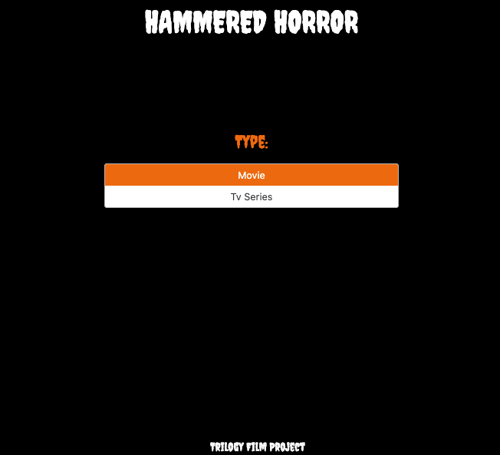

Slide 6
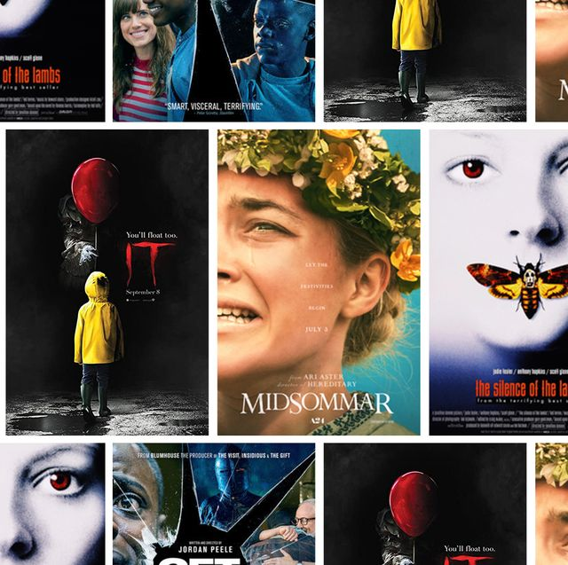
Concept: Motivation for development?
We’re all horror fans!
We found streaming service “Recommended for you” recommendations can be a bit general or repetitive when it comes to horror...
Horror films cover such a broad range of styles often uniquely characterised by their subgenres, nationality and era/year of creation - perhaps more than any other genre of film. e.g Psychological horrors vs. Slasher films, horror films from the 70s vs 90s etc.
Horror films can be disappointing far more often than they are rewarding - surely there’s a simpler way of picking a good horror to watch

Slide 7
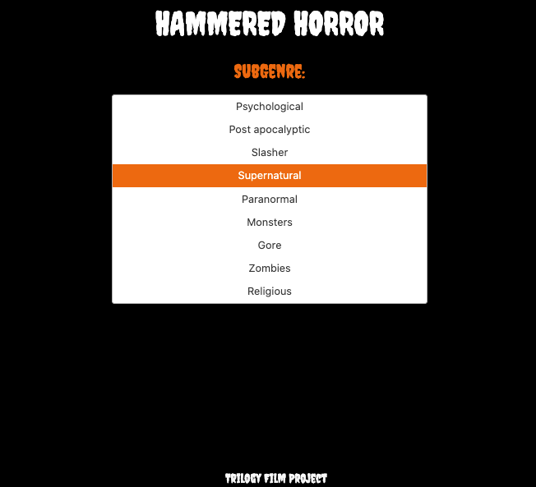

Slide 8
Concept: User story
As a horror fanatic with nothing else to do during the pandemic, I have watched more fright-fests than ever. Yet with so many horror flicks, with so many sub-genres, being made all over the world, all the time…. Picking the right horror film to match my mood can be a complete nightmare! And even after I’ve found one that I think looks like a winner, it’s so often a total shocker. If only I had an app like a “Sixth Sense”…. I want an app that only searches horror TV and film releases. I want to be able to specify what type of horror film I want to watch by subgenre, nationality and year. I want to be recommended a list of titles and their respective posters that match this criteria. I want to see details of each of the recommended films such as age certificate, director, title, and cover image. I want a simple way of telling whether the film will be a treat, rather than a trick. I want to save films I want to watch to my own horror collection library so I can revisit them later.

Slide 9
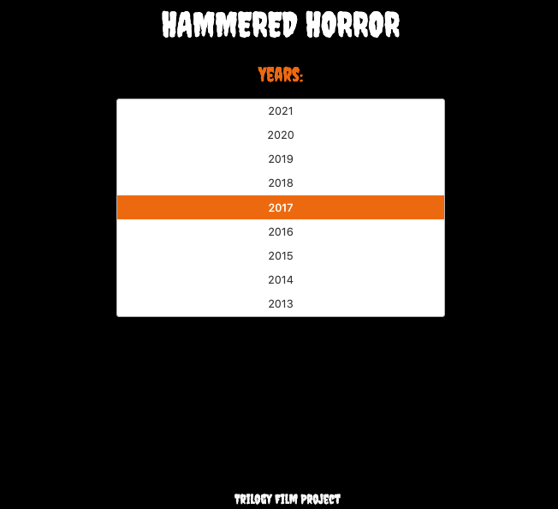

Slide 10

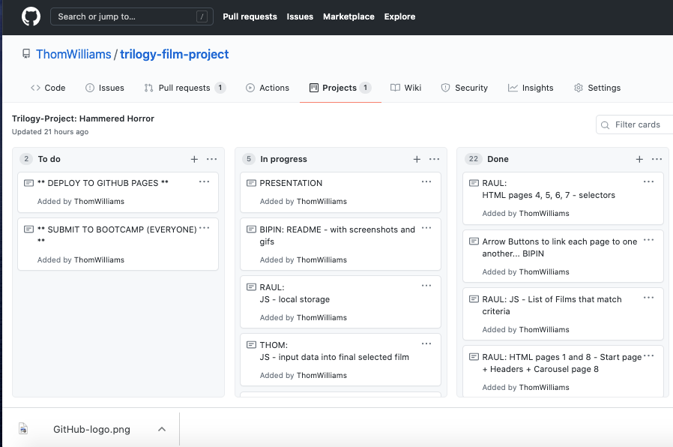
Process: Technologies Used: GitHub
GITHUB - The team employed an agile software development style to collaboratively and systematically engineer the app via Github.
The app has been deployed via GitHub Pages.
We used the GitHub Projects to assign tasks to each member of the group.

Slide 11
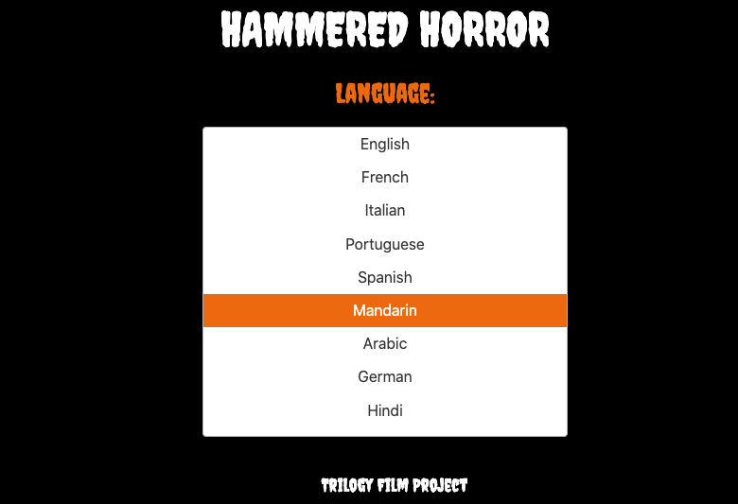

Slide 12

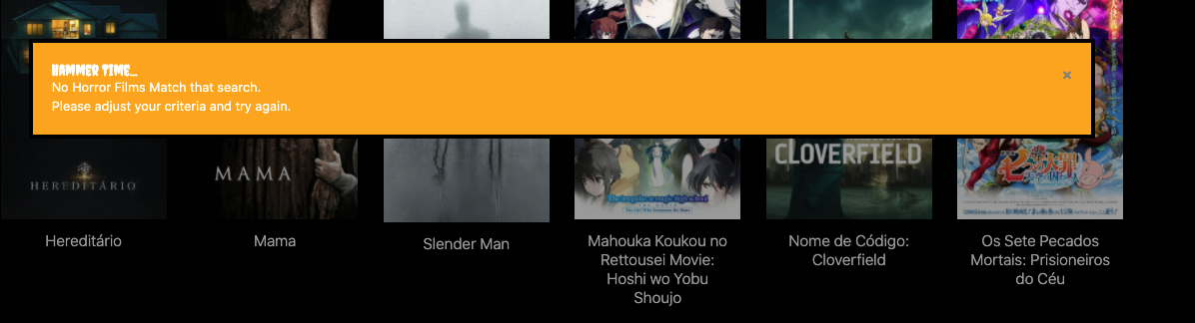
Process: Technologies Used: Javascript
Interactive navigation through dynamically created film selectors and enable response to user input.
Enables client-side storage to store persistent data to the “Saved Films” window.
Generate “Hammer Time” modal if no movies match the user’s criteria (rare)
Calls to the API’s we used...

Slide 13



Process: Technologies Used: CSS Frameworks
Materialize - used to define the layout of the HTML pages, selectors and cards (selected films).
Google Fonts - provided the distinctive Hammer Horror font (Creepy).
FontAwesome - To insert the Horror Icons
Bulma utilised to enhance the form selector that houses the list of movies that match user criteria
Ultimately used all to give the Hammered Horror app its clean, polished, and mobile responsive design.

Slide 14
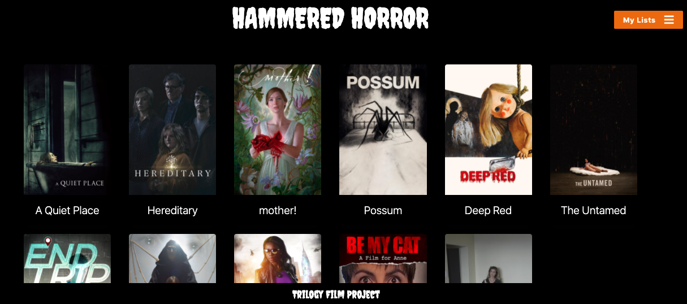

Slide 15
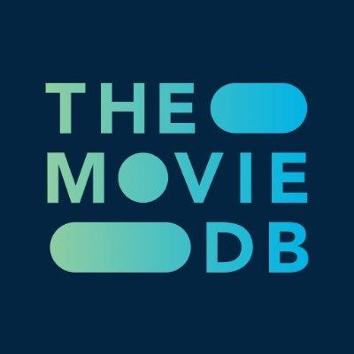
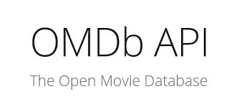
Process: Technologies Used: Server Side APIs
Two APIs used: - THE MOVIE DB - to access general data on a wide range of horror films and shows, plus subgenre/keyword and language reference data necessary for defining the user selection. - OMDB (The Open Movie Database) - to cross reference collective critical scores from three different databases (Rotten Tomatoes, IMDB and Metacritic) which were essential to the “Trick” Or “Treat” functionality.

Slide 16
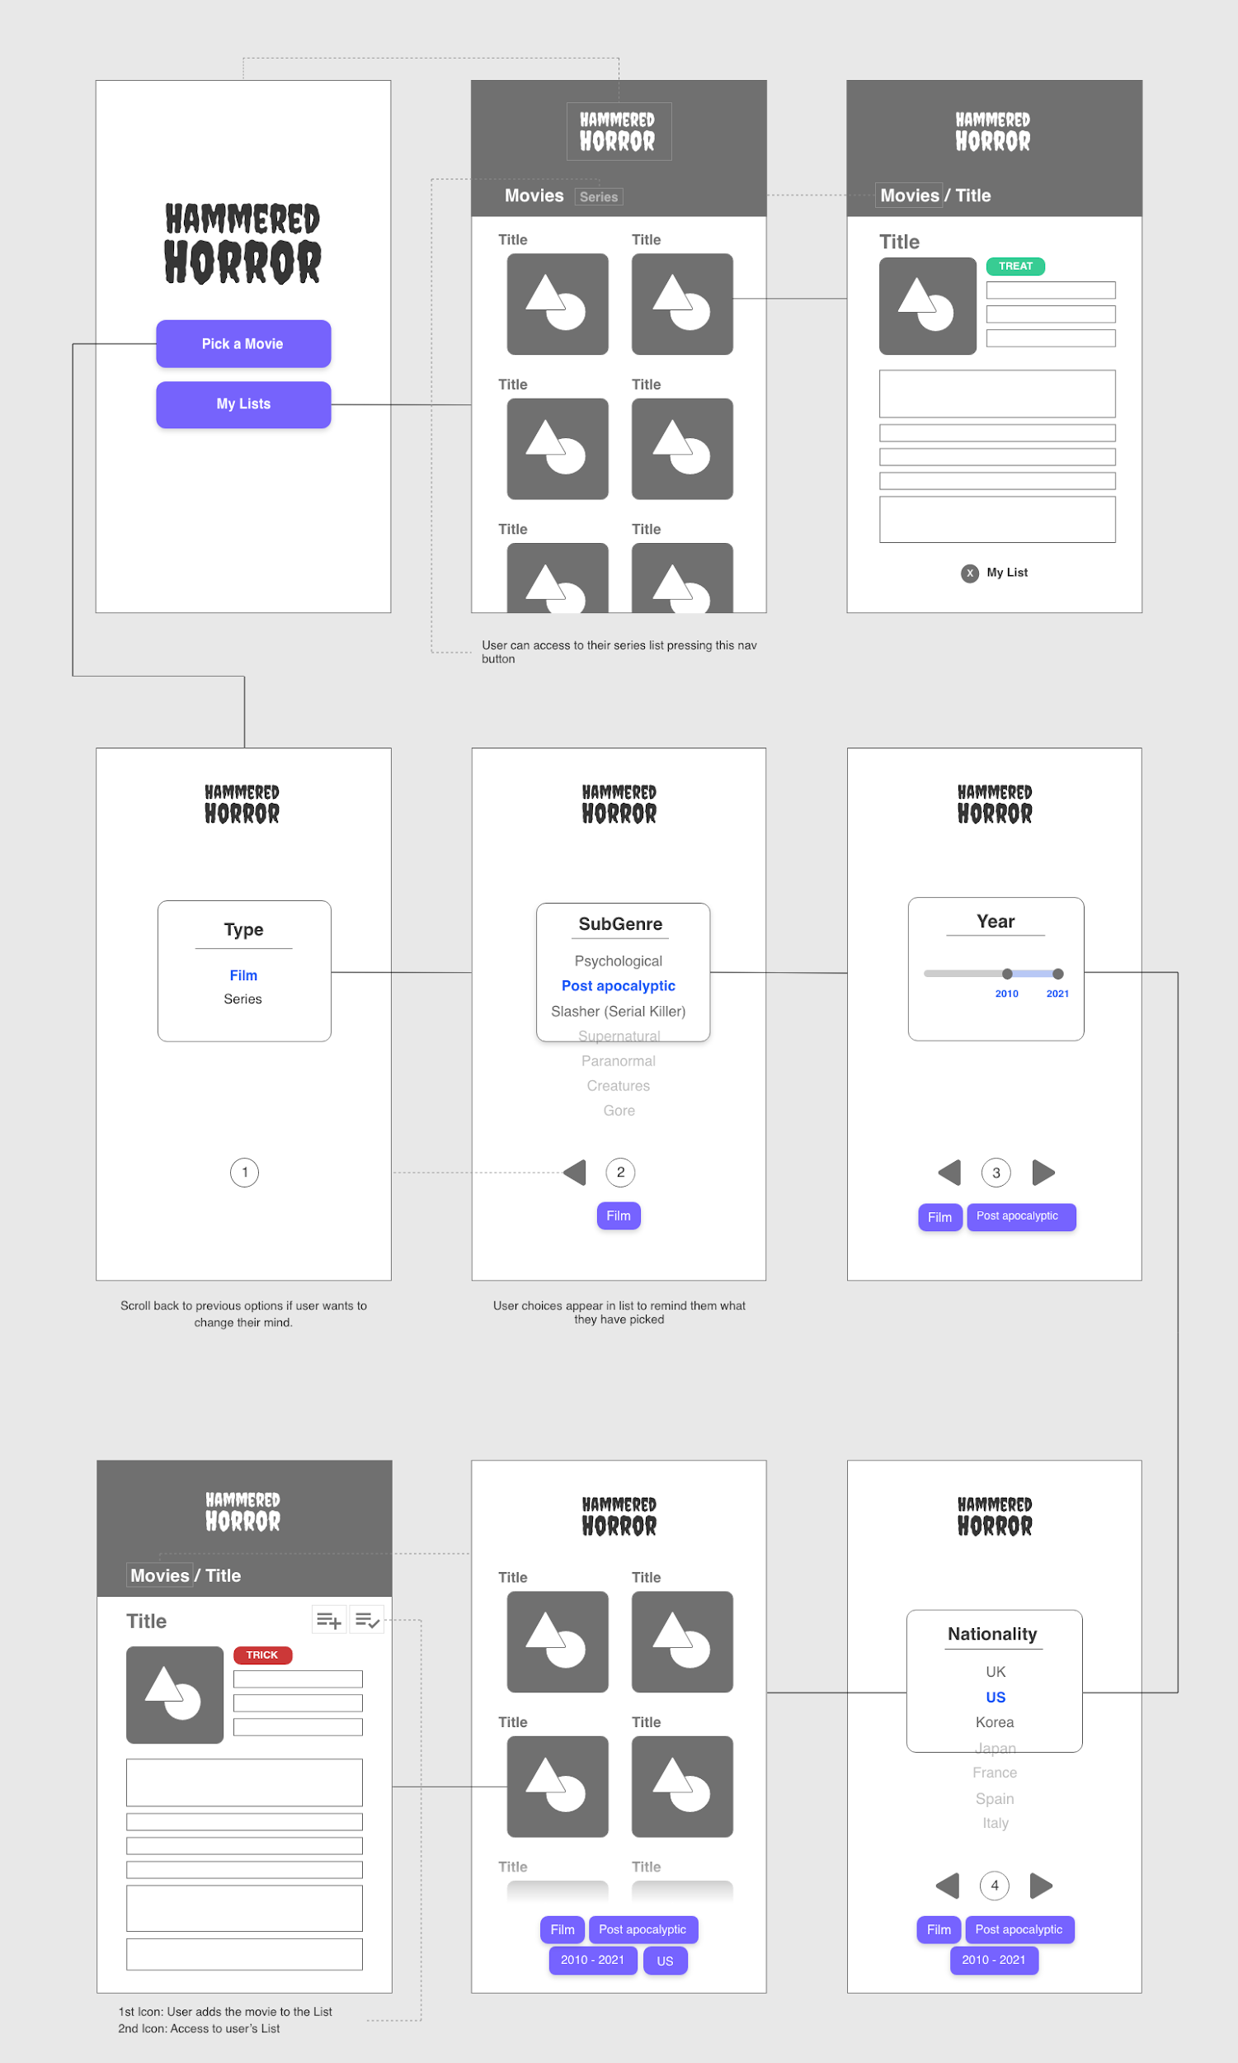
Process: Tasks & Roles
Devised the concept.
Created a wireframe around the concept and then divided the app into its core components:
Start Page (All)
Selectors (Bipin)
Movies that match user criteria + Save Gallery (Raul)
Final Selected Movie Screen (Thom)

Slide 17
Process: Tasks & Roles
Divided up the key functionality:
Call to The Movie DB API, plus application and display of data for user selections (Raul)
Call to The OMDB API and display of data for final selected film (Thom)
Trick Or Treat Functionality (Thom)
LocalStorage + Library (Raul)
Error Modal (Thom)
Other Tasks: - Styling, CSS frameworks and font selection (Raul + Bipin) - Mobile Responsiveness (Raul) - README, gif demo, screenshots (Bipin) - Presentation (Thom) - Clean Repository - indentation, comments (All)

Slide 18
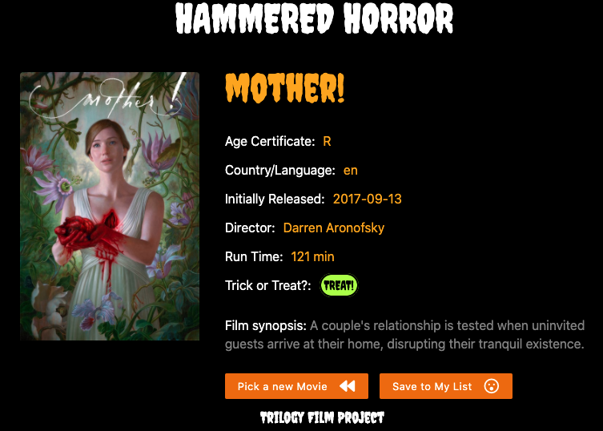

Slide 19






Process: Challenges
GitHub - various conflicts
Differing visions of our Minimum Viable Product.
Discrepancies in data when connecting the API’s e.g. the OMDB and The Movie DB.
Rotten Tomatoes and IMDB official APIs require formal application process, which was initially denied.
IMDB, Rotten Tomatoes and Metacritic scores are not always universally available in the OMDB database which can impact the “trick or treat” outcome.

Slide 20
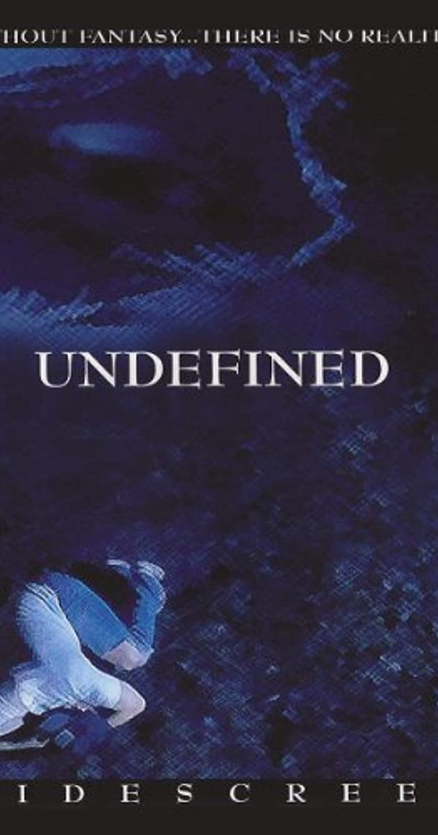
Process: Challenges
Undefined - The Movie! - Limitations on the number of calls to the databases can generate “Undefined” film selection.
Local Storage - Individual HTML pages as opposed to dynamically created elements caused issues with regard to the storage of data.
Bulma & materialize conflicts of styling
Struggled to find a selector that quite matched the one in our wire frame
Time management - finding the work/course balance between all three of us

Slide 21
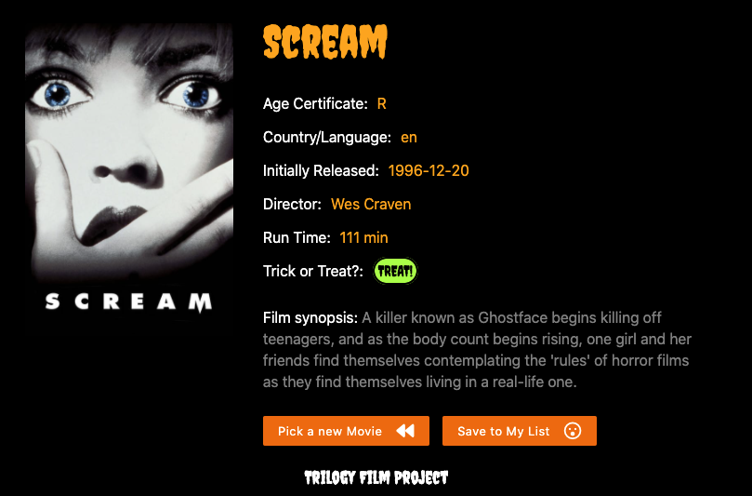

Slide 22
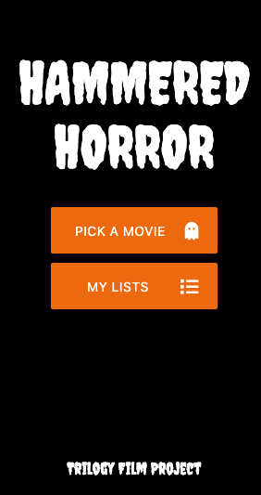
Process: Successes
Hammered Horror app is representative of the vision in initial wireframe.
Fun, user friendly application that will appeal to both horror and general film fans.
Offers horror fans the option to discover films based on how they are feeling at that current moment, as opposed to algorithmic estimates of what they have “recently watched” as typically offered other streaming services

Slide 23
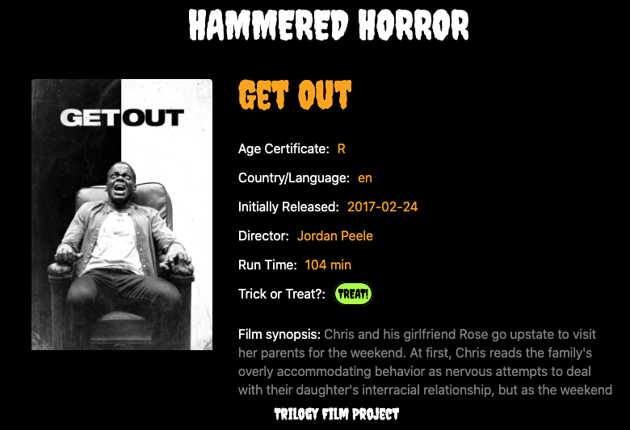
Process: Successes
Mobile responsive, clean, polished (spooky!) layout and design.
Novel “trick or treat” verdict to help guide film selection - with some surprising outcomes to entertain users.
Product finished ahead of deadline (Thursday).

Slide 24
Demo

Slide 25

Notes:
https://thomwilliams.github.io/trilogy-film-project/

Slide 26
Directions for Future Development:
Tell users where they can watch the selected title e.g Netflix, Amazon (which will require further API’s such as GoWatchIt)
Additional selectors to help users find the perfect movie e.g awards a movie has won, select a range a years as opposed to just a single year.
Include additional interactive content e.g. trailers.
Find ways to eradicate any discrepancies in the data provided (e.g. if name of director is not provided by the API).
Further development of “Trick” Or “Treat” rating rules and data comparisons
Fright factor rating - a scale of how scary a film / series is…

Slide 27
Links
https://thomwilliams.github.io/trilogy-film-project/
https://github.com/ThomWilliams/trilogy-film-project

Slide 28
